Slide 1
Exam 70-534 Architecting Microsoft Azure Solutions
#1 Design Azure Resource Manager (ARM) networking (5–10%)
Design Azure virtual networks - Extend on-premises
Describe Azure VPN and Express Route architecture and design
#2 Secure resources (20–25%)
Secure resources by using managed identities
Secure resources by using managed identities
Secure resources by using identity providers
Identify an appropriate data security solution
Design a role-based access control (RBAC) strategy
Manage security risks by using an appropriate security solution
#3 Design an application storage and data access strategy (5–10%)
Design data storage
Select the appropriate storage option
#4 Design advanced applications (20–25%)
Create compute-intensive applications
Create long-running applications
Integrate Azure services in a solution
Implement messaging applications
Implement applications for background processing
Design connectivity for hybrid applications
#5 Design Azure Web and Mobile Apps (5–10%)
Design Web Applications
Design Mobile Applications
#6 Design a management, monitoring, and business continuity strategy (20–25%)
Design a monitoring strategy
Describe Azure business continuity/disaster recovery (BC/DR) capabilities
Design a disaster recovery strategy
Design Azure Automation and PowerShell workflows
Describe the use cases for Azure Automation configuration
#7 Architect an Azure Compute infrastructure (10–15%)
Design ARM Virtual Machines (VMs)
Design ARM template deployment
Design for availability
+ Bonus: Containers
https://www.microsoft.com/learning/en-us/exam-70-534.aspx

Slide 2

Securing Resources
Managed Identities
Hybrid Identities
Identity Providers
Data Security
RBAC

Slide 3
#2 Secure resources (20–25%)
1. Secure resources by using managed identities
Describe the differences between Active Directory on-premises and Azure Active Directory (Azure AD),
Programmatically access Azure AD using Graph API,
Secure access to resources from Azure AD applications using OAuth and OpenID Connect
2. Secure resources by using hybrid identities
Use SAML claims to authenticate to on-premises resources, describe AD Connect synchronization, implement federated identities using Active Directory Federation Services (ADFS)
3. Secure resources by using identity providers
Provide access to resources using identity providers, such as Microsoft account, Facebook, Google, and Yahoo!;
Manage identity and access by using Azure AD B2C
Implement Azure AD B2B
4. Identify an appropriate data security solution
Identify security requirements for data in transit and data at rest;
Identify security requirements using Azure services, including Azure Storage Encryption, Azure Disk Encryption, and Azure SQL Database TDE
5. Design a role-based access control (RBAC) strategy
Secure resource scopes, such as the ability to create VMs and Azure Web Apps;
Implement Azure RBAC standard roles
Design Azure RBAC custom roles
6. Manage security risks by using an appropriate security solution
Identify, assess, and mitigate security risks by using Azure Security Center, Operations Management Suite, and other services

Slide 4
Secure resources by using managed identities

Slide 5
Active Directory On-Premises vs Azure AD
Active Directory On-Premise | Azure AD
Authentication Provider | Authentication Provider
Internal single customer directory service | Multi-customer public directory service
Hierarchical structure of: Users, Computers, Groups, Services | Flat structure of: Users and Groups
Group Policy and DNS data | NA
Can be accessed using LDAP | Can be accessed using Graph API
Primarily uses Kerberos for authentication | Authentication can use SAML, WS-Federation and OAuth
Notes:
Azure Active Directory (Azure AD) is a comprehensive identity and access management cloud solution that gives you a robust set of capabilities to manage users and groups. It helps secure access to on-premises and cloud applications, including Microsoft web services like Office 365, and many non-Microsoft software as a service (SaaS) applications.

Slide 6
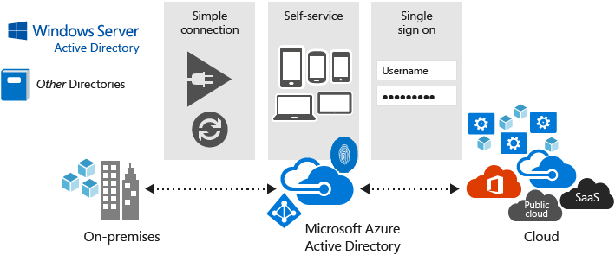
Azure AD
Notes:
Azure Active Directory (Azure AD) is Microsoft’s multi-tenant, cloud based directory and identity management service. Azure AD combines core directory services, advanced identity governance, and application access management

Slide 7
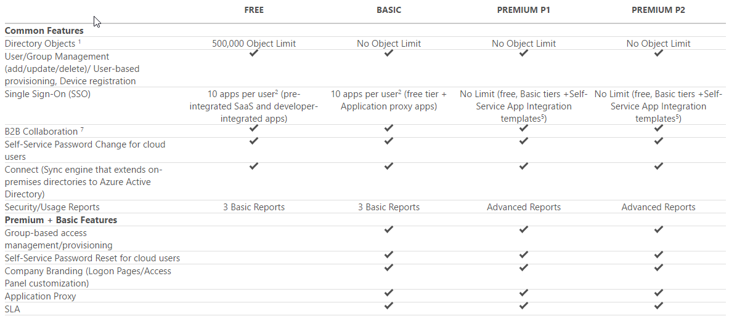
Azure AD Edition Features
https://azure.microsoft.com/en-us/pricing/details/active-directory/
Notes:
https://azure.microsoft.com/en-us/pricing/details/active-directory/

Slide 8
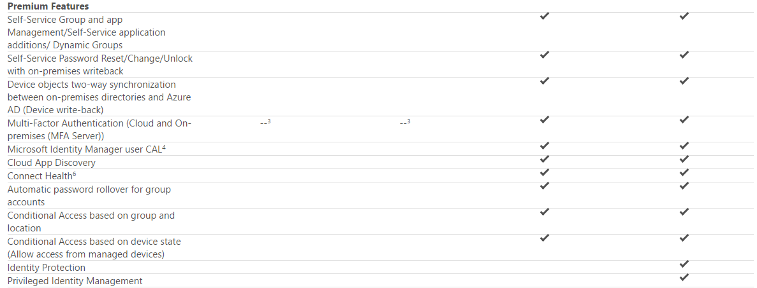
Azure AD Premium Features
https://azure.microsoft.com/en-us/pricing/details/active-directory/
Notes:
https://azure.microsoft.com/en-us/pricing/details/active-directory/

Slide 9
Which Azure AD editions provide self service password reset?
Free
Basic
Premium

Slide 10
Which Azure AD editions provide self service password reset?
2) Basic
3) Premium

Slide 11
Access Azure AD using Graph API
REST API endpoints (OData 3.0 compliant)
Supports common operations:
Create a new user in a directory
Get a user’s detailed properties
Update a user’s properties
Check a user’s group membership for role-based access
Disable a user’s account or delete it entirely
NOTE: Microsoft Graph is the next up and coming way to do this
Notes:
Open Data Protocol (OData) is an open protocol which allows the creation and consumption of queryable and interoperable RESTful APIs in a simple and standard way.
Azure Active Directory Graph API
https://docs.microsoft.com/en-us/azure/active-directory/develop/active-directory-graph-api
Get started with Azure Active Directory Identity Protection and Microsoft Graph
https://docs.microsoft.com/en-us/azure/active-directory/active-directory-identityprotection-graph-getting-started

Slide 12
Steps to using Graph API
Three steps to accessing Microsoft Graph API
Add application with a client secret
Use secret and other info to authenticate to Graph API and get token
Use returned token to make requests to the API endpoint
https://graph.windows.net/{tenantId}/{resourcePath}?{apiVersion}
Notes:
Programmatically access Azure AD using Graph API
Operations overview | Graph API concepts
https://msdn.microsoft.com/Library/Azure/Ad/Graph/howto/azure-ad-graph-api-operations-overview
Graph API reference
https://msdn.microsoft.com/Library/Azure/Ad/Graph/api/api-catalog

Slide 13
Which of the following are needed to interact with the Graph API?
Access Token
The Azure AD Application Key
The Azure AD Tenant ID
Refresh Token

Slide 14
Which of the following are needed to interact with the Graph API?
Access Token
The Azure AD Application Key
The Azure AD Tenant ID

Slide 15
OAuth 2.0 and OpenID Connect
OAuth 2.0
Open standard for authorization
Implemented as an authorization protocol versus an authentication protocol
Focused on what resources you have access to
OpenID Connect
Extends the OAuth 2.0 authorization protocol to use as an authentication protocol
Enables SSO with OAuth
https://docs.microsoft.com/en-us/azure/active-directory/develop/active-directory-v2-protocols
Notes:
OAuth spec
https://tools.ietf.org/html/rfc6749#section-4.1
OpenID spec
http://openid.net/specs/openid-connect-core-1_0.html
OpenID Connect Hybrid Flow and IdentityServer v3
https://leastprivilege.com/2014/10/10/openid-connect-hybrid-flow-and-identityserver-v3/

Slide 16
Oauth 2.0 Endpoints
Authorization Endpoint
The authorization endpoint is the endpoint on the authorization server where the resource owner logs in, and grants authorization to the client application.
Token Endpoint
The token endpoint is the endpoint on the authorization server where the client application exchanges the authorization code, client ID and client secret, for an access token.
Redirect Endpoint
The redirect endpoint is the endpoint in the client application where the resource owner is redirected to, after having granted authorization at the authorization endpoint.

Slide 17
Terms
authentication is to verify if an entity is indeed what it claims to be
authorization is the process of determining whether an authenticated user has access to certain functionalities provided by the service provider
claim is an assertion made on an attribute of an entity (think property or descriptor or attribute)
refresh token is optionally issued with the access token and is a longer lasting credential (than the access token) solely used to request additional access tokens.
identity token or id token is OpenID’s extension to OAuth 2. The structure is similar to the access token, but indicates user authentication -not authorization. (aka authorization token)
client refers to the mobile app, web app, etc. that wants to access a resource
resource owner has control of resources that are being secured
security token is a collection of claims. It is often digitally signed, encrypted, and transferred through secured channels to ensure its conﬁdentiality, integrity, and authenticity (aka access token)
service provider provides requested services (aka relying party)
identity provider authenticates entities and issues security tokens to relying parties (aka security token service STS or authorization server AS)
Notes:
Secure access to resources from Azure AD applications using OAuth and OpenID Connect
Authorize access to web applications using OAuth 2.0 and Azure Active Directory
https://docs.microsoft.com/en-us/azure/active-directory/develop/active-directory-protocols-oauth-code
Azure AD Code Samples
https://azure.microsoft.com/en-us/resources/samples/?service=active-directory
Integrate Azure AD into a web application using OpenID Connect
https://azure.microsoft.com/en-us/resources/samples/active-directory-dotnet-webapp-openidconnect/

Slide 18
Important Flows
Authorization Code Flow
The Authorization Code Flow returns an Authorization Code to the Client, which can then exchange it for an ID Token and an Access Token directly.
Implicit Flow
The Implicit Flow is mainly used by Clients implemented in a browser using a scripting language. The Access Token and ID Token are returned directly to the Client.
Hybrid Flow
The Hybrid Flow, some tokens are returned from the Authorization Endpoint and others are returned from the Token Endpoint.
https://docs.microsoft.com/en-us/azure/active-directory/develop/active-directory-v2-protocols-implicit
Notes:
OAuth spec
https://tools.ietf.org/html/rfc6749#section-4.1
OpenID spec
http://openid.net/specs/openid-connect-core-1_0.html
OpenID Connect Hybrid Flow and IdentityServer v3
https://leastprivilege.com/2014/10/10/openid-connect-hybrid-flow-and-identityserver-v3/

Slide 19
Authorization Flow and Implicit Flow
Authorization Code Flow | Implicit Flow
1. Client prepares an Authentication Request containing the desired request parameters. 2. Client sends the request to the Authorization Server. 3. Authorization Server Authenticates the End-User. 4. Authorization Server obtains End-User Consent/Authorization. 5. Authorization Server sends the End-User back to the Client with an Authorization Code. 6. Client requests a response using the Authorization Code at the Token Endpoint. 7. Client receives a response that contains an ID Token and Access Token in the response body. 8. Client validates the ID token and retrieves the End-User's Subject Identifier. | 1. Client prepares an Authentication Request containing the desired request parameters. 2. Client sends the request to the Authorization Server. 3. Authorization Server Authenticates the End-User. 4. Authorization Server obtains End-User Consent/Authorization. 5. Authorization Server sends the End-User back to the Client with an ID Token and, if requested, an Access Token. 6. Client validates the ID token and retrieves the End-User's Subject Identifier.
Notes:
The Hybrid Flow follows the following steps:
1. Client prepares an Authentication Request containing the desired request parameters.
2. Client sends the request to the Authorization Server.
3. Authorization Server Authenticates the End-User.
4. Authorization Server obtains End-User Consent/Authorization.
5. Authorization Server sends the End-User back to the Client with an Authorization Code and, depending on the Response Type, one or more additional parameters.
6. Client requests a response using the Authorization Code at the Token Endpoint.
7. Client receives a response that contains an ID Token and Access Token in the response body.
8. Client validates the ID Token and retrieves the End-User's Subject Identifier.

Slide 20
Secure Using OAuth and OpenID Connect
app.UseOpenIdConnectAuthentication(
new OpenIdConnectAuthenticationOptions
{
ClientId = clientId, // The Client ID uniquely identifies application to Azure AD.
Authority = Authority,//https://login.microsoftonline.com/{tenantId} Sign-in URL of tenant
PostLogoutRedirectUri = redirectUri,
RedirectUri = redirectUri, // Redirect Uri is the URL where the user will be redirected
// NOTE: handlers are in order of when they get called
Notifications = new OpenIdConnectAuthenticationNotifications()
{
RedirectToIdentityProvider = OnRedirectToIdentityProvider,
MessageReceived = OnMessageReceived,
SecurityTokenReceived = OnSecurityTokenReceived,
SecurityTokenValidated = OnSecurityTokenValidated,
AuthorizationCodeReceived = OnAuthorizationCodeReceived,
AuthenticationFailed = OnAuthenticationFailed
}
});
Notes:
Secure access to resources from Azure AD applications using OAuth and OpenID Connect
Authorize access to web applications using OpenID Connect and Azure Active Directory
https://docs.microsoft.com/en-us/azure/active-directory/develop/active-directory-protocols-openid-connect-code
Authorize access to web applications using OAuth 2.0 and Azure Active Directory
https://docs.microsoft.com/en-us/azure/active-directory/develop/active-directory-protocols-oauth-code
Azure AD Code Samples
https://azure.microsoft.com/en-us/resources/samples/?service=active-directory
Integrate Azure AD into a web application using OpenID Connect
https://azure.microsoft.com/en-us/resources/samples/active-directory-dotnet-webapp-openidconnect/

Slide 21
When using OAuth and OpenID Connect, which notification handler will you know the user is a valid logged in Azure AD user?
RedirectToIdentityProvider
MessageReceived
SecurityTokenReceived
SecurityTokenValidated
AuthorizationCodeReceived
AuthenticationFailed

Slide 22
When using OAuth and OpenID Connect, which notification handler will you know the user is a valid logged in Azure AD user?
AuthorizationCodeReceived

Slide 23
Quite a few components participate in an authentication and authorization workflow. Understanding how they interact with one another is the key to a successful implementation.

Slide 24
Secure resources by using hybrid identities

Slide 25
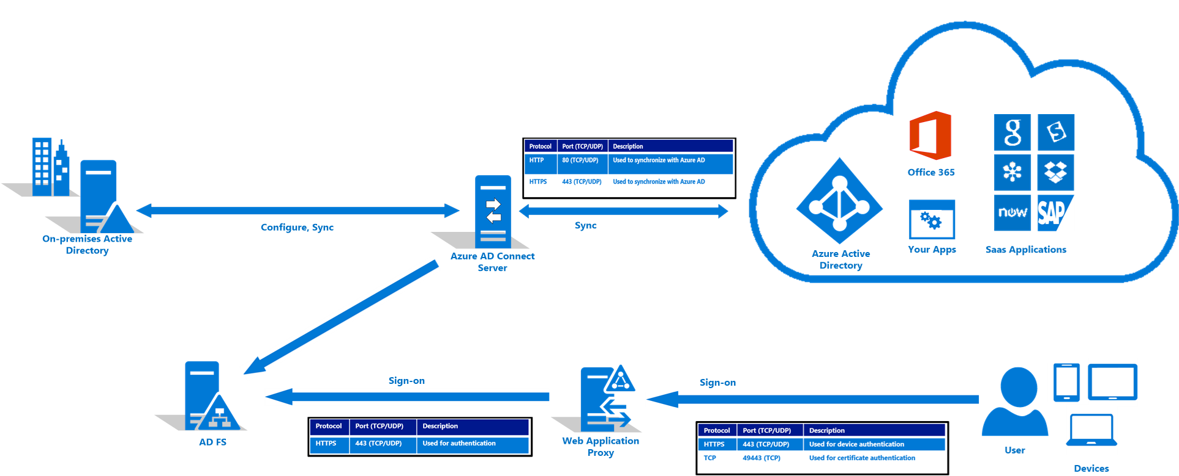
AD FS
Notes:
AD FS stands for Active Directory Federation Services, and it allows you to use your on-prem AD as an identity provider, so you'd be able to continue to use your on-prem AD, and it would serve as the source of truth for user identity.
While ACS is deprecated, AD FS is alive and well. It can be used with Azure AD Connect to serve as the same identity provider that it did with ACS, and that would allow for things such as better password policies, or the ability to enforce scheduled login times and things like this, though there's also more setup and maintenance involved.

Slide 26
AD FS
Simplicity and consistency
Use the same set of APIs and patterns to enable sign on
Use the same set of libraries you can already use to authenticate users against Azure AD
Flexibility
In addition to standard user authorization, enable more complex scenarios
Industry support
OAuth 2.0 and OpenID Connect enjoy wide utilization across the industry, so knowledge of these patterns will help you enable authentication and authorization outside of an Active Directory environment as well
Notes:
Simplicity and consistency
Use the same set of APIs and patterns to enable sign on for:
multiple types of applications (server, desktop, mobile, browser)
multiple platforms (android, iOS, Windows)
applications inside the corporate network or hosted in the cloud
Use the same set of libraries you can already use to authenticate users against Azure AD
Flexibility
In addition to standard user authorization, enable more complex scenarios such as:
3-legged sign on flows in which a user authorizes one web application or service to access resources that reside with another web app or service.
Server-to-server flows in which a mid-tier service accesses a back end API
JavaScript based single-page applications (SPA)
Industry support
OAuth 2.0 and OpenID Connect enjoy wide utilization across the industry, so knowledge of these patterns will help you enable authentication and authorization outside of an Active Directory environment as well

Slide 27
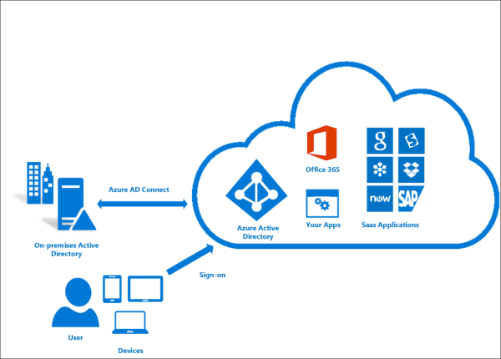
AD Connect
Notes:
Azure AD Connect is the best way to connect your on-premises directory with Azure AD and Office 365. This is a great time to upgrade to Azure AD Connect from Windows Azure Active Directory Sync (DirSync) or Azure AD Sync as these tools are now deprecated and will reach end of support on April 13, 2017.
Azure AD Connect will integrate your on-premises directories with Azure Active Directory. This allows you to provide a common identity for your users for Office 365, Azure, and SaaS applications integrated with Azure AD. This topic will guide you through the planning, deployment, and operation steps. It is a collection of links to the topics related to this area.
https://docs.microsoft.com/en-us/azure/active-directory/active-directory-hybrid-identity-design-considerations-tools-comparison
DEMO: AD Connect Basic Configuration and Forced Sync using Powershell
https://docs.microsoft.com/en-us/azure/active-directory/connect/active-directory-aadconnectsync-feature-scheduler

Slide 28
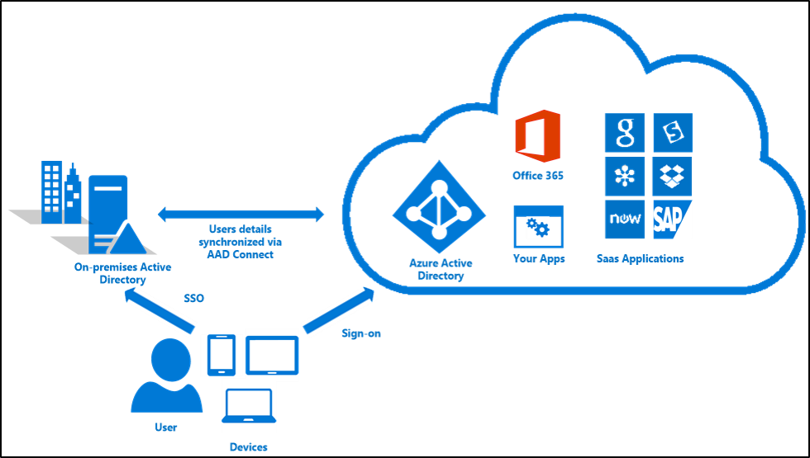
AD Connect SSO
Notes:
Azure Active Directory Seamless Single Sign On (Azure AD Seamless SSO) provides true single sign on for users signing in on their corporate desktops connected on the corporate network. When enabled, users won't need to type in their passwords to sign in to Azure AD, and in most cases, even type in their usernames. This feature provides your users easy access to your cloud-based services without needing any additional on-premises components.

Slide 29
AD Connect SSO - Requirements
Your user is signing in on a corporate desktop.
The desktop has been previously joined to your Active Directory (AD) domain.
The desktop has a direct connection to your Domain Controller (DC), either on the corporate wired or wireless network or via a remote access connection, such as a VPN connection.
Our service endpoints have been included to the browser's Intranet zone.
Notes:
For this feature to work for a specific user, the following conditions need to be met:
Your user is signing in on a corporate desktop.
The desktop has been previously joined to your Active Directory (AD) domain.
The desktop has a direct connection to your Domain Controller (DC), either on the corporate wired or wireless network or via a remote access connection, such as a VPN connection.
Our service endpoints have been included to the browser's Intranet zone.
If any of the above conditions are not met, then the user will be prompted to enter their username and password as before.

Slide 30
Secure resources by using identity providers

Slide 31
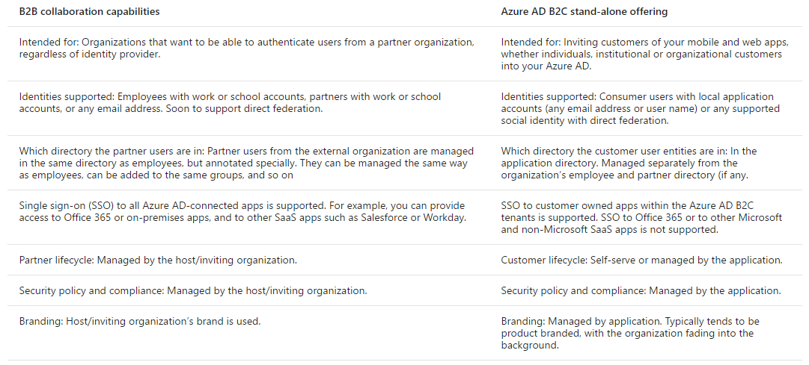
Azure AD B2B vs Azure AD B2C
Notes:
Azure AD B2B is a feature of Azure AD called Azure AD B2B collaboration

Slide 32
Implement Azure AD B2B Collaboration
B2B collaboration allows you to invite users outside of your organization and manage access to applications and resources.
Can add invited users to:
Enterprise applications
Directory Users
Groups
Can utilize API to build custom application using B2B
Notes:
Implement Azure AD B2B
What is Azure AD B2B collaboration?
https://docs.microsoft.com/en-us/azure/active-directory/active-directory-b2b-what-is-azure-ad-b2b
Properties of an Azure Active Directory B2B collaboration user
https://docs.microsoft.com/en-us/azure/active-directory/active-directory-b2b-user-properties
Azure Active Directory B2B collaboration API and customization
https://docs.microsoft.com/en-us/azure/active-directory/active-directory-b2b-api
Demonstration/prototype of B2B self-service signup, signup approvals, and profile editing.
https://github.com/Azure/active-directory-dotnet-graphapi-b2bportal-web

Slide 33
You have a web application using Azure AD for its users. You now need to add users that work for a partner company. What is the easiest way to give the new external users access to your web application?
Change the web application to use a Azure B2C directory
Change your Azure AD to use the Premium edition
Invite the users from Azure AD (using Azure B2B)
Add the users to your internal Active Directory and sync

Slide 34
You have a web application using Azure AD for its users. You now need to add users that work for a partner company. What is the easiest way to give the new external users access to your web application?
3) Invite the users from Azure AD (using Azure B2B)

Slide 35
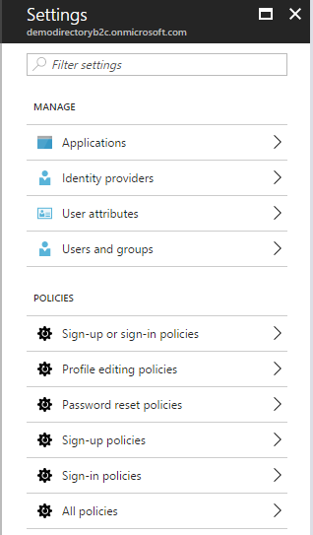
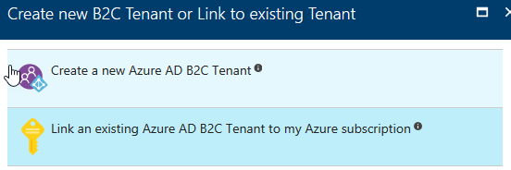
Manage Identity and access by using Azure AD B2C
Once you create Azure AD B2C, you need to link it
Allows you to add users from
Social accounts
Enterprise Accounts
Local Accounts
Can set policies
Can Brand login experience
Notes:
Manage Identity and access by using Azure AD B2C
Azure Active Directory B2C: Enable Multi-Factor Authentication in your consumer-facing applications
https://docs.microsoft.com/en-us/azure/active-directory-b2c/active-directory-b2c-reference-mfa
Azure Active Directory B2C: Create an Azure AD B2C tenant
https://docs.microsoft.com/en-us/azure/active-directory-b2c/active-directory-b2c-get-started
Azure AD B2C: Focus on your app, let us worry about sign-up and sign-in
https://docs.microsoft.com/en-us/azure/active-directory-b2c/active-directory-b2c-overview

Slide 36
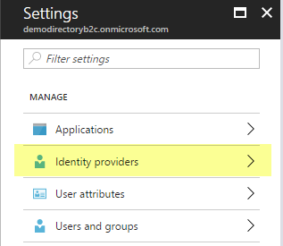
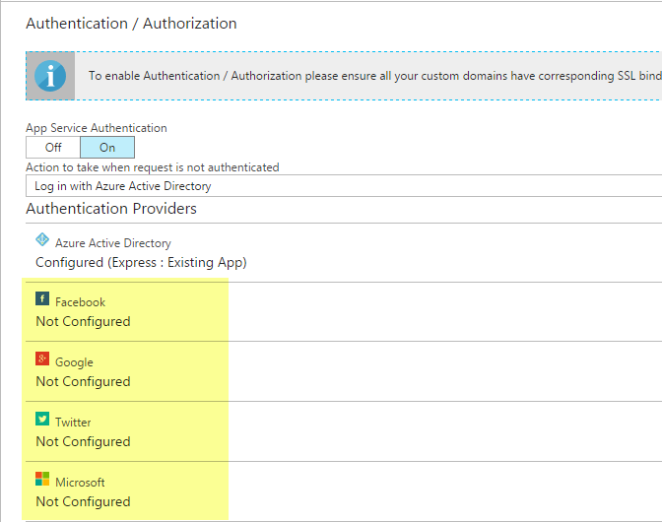
Provide access to resources using identity providers
Configure Identity Providers in Azure AD B2C
Configure in App Service Authentication blade
Notes:
Provide access to resources using identity providers, such as Microsoft Account, Facebook, Google and Yahoo!
Azure AD B2C: Focus on your app, let us worry about sign-up and sign-in
https://docs.microsoft.com/en-us/azure/active-directory-b2c/active-directory-b2c-overview
Azure Active Directory B2C: Provide sign-up and sign-in to consumers with Microsoft accounts
https://docs.microsoft.com/en-us/azure/active-directory-b2c/active-directory-b2c-setup-msa-app

Slide 37
You have a web application that needs to support Single Sign On for your on-premise users and be able to add external users using their social logins. Which product will be the best to use?
Azure AD B2C
Key Vault
Security Center
Azure B2B Collaboration

Slide 38
You have a web application that needs to support Single Sign On for your on-premise users and be able to add external users using their social logins. Which product will be the best to use?
Azure AD B2C

Slide 39
Azure B2C allows you to add social accounts, enterprise accounts and local accounts. It is very flexible and newer than Azure AD. The exam may not call out Azure B2C or Azure B2B Collaboration, but you will need to know how to provide the solutions they solve. In preparing for the exam, you should try to explore both types of Azure AD directories and learn the pros and cons.
Notes:
The future of Azure ACS is Azure Active Directory
https://blogs.technet.microsoft.com/enterprisemobility/2015/02/12/the-future-of-azure-acs-is-azure-active-directory/

Slide 40
Identify an appropriate data security solution

Slide 41
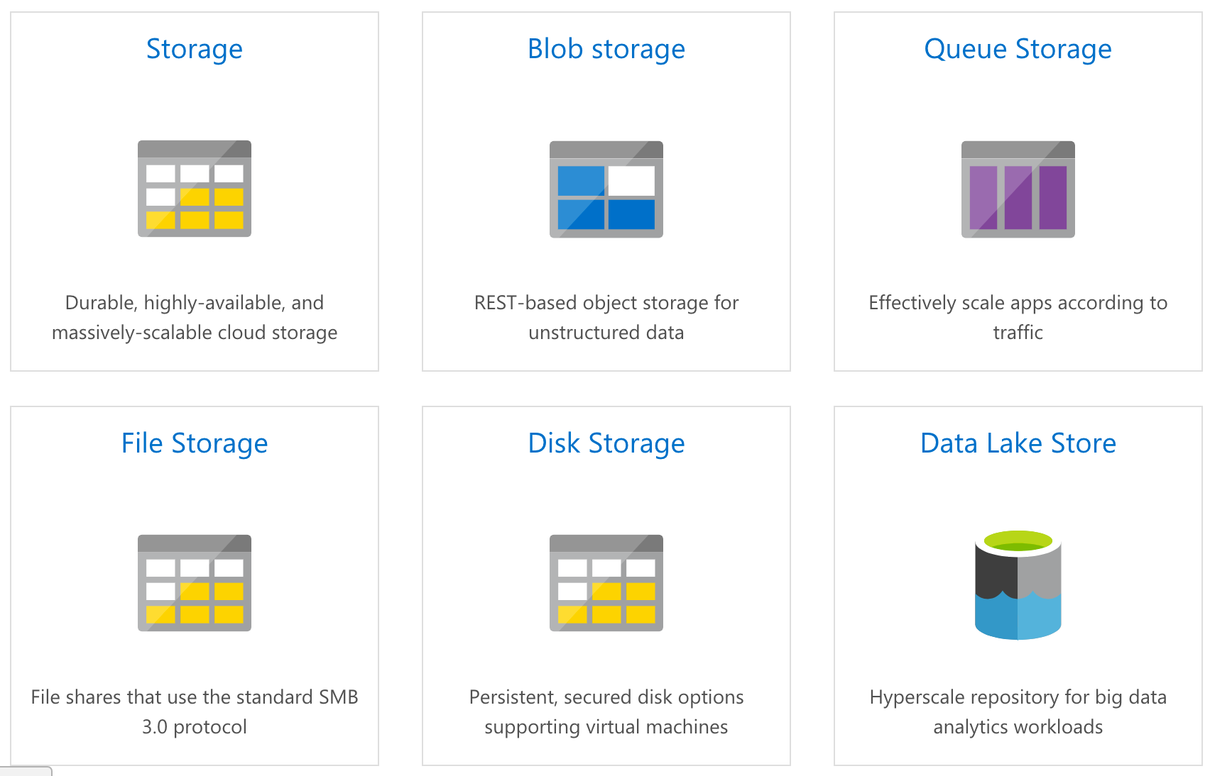
Azure Storage
Notes:
Azure Storage Service is a single service with different types of storage including options for Object, Table, Disk and Queue storage.
Currently, Azure allows the encryption of blobs using a managed form of encryption. Azure will seamlessly encrypt the data before persisting it and decrypt it before reading it and you can enable this feature with a toggle switch and then anything that's newly added is going to be encrypted, and if you were to disable encryption then similarly to before, anything newly added won't be encrypted. And it's important to note this functionality is only for the Resource Manager storage accounts, not the classic so that toggle is going to handle data at rest for blob storage. For data in transit, you can use https. For the other storage options, you'll want to use the https option for in transit. However, for data at rest, you're going to have to bring your own solution.

Slide 42
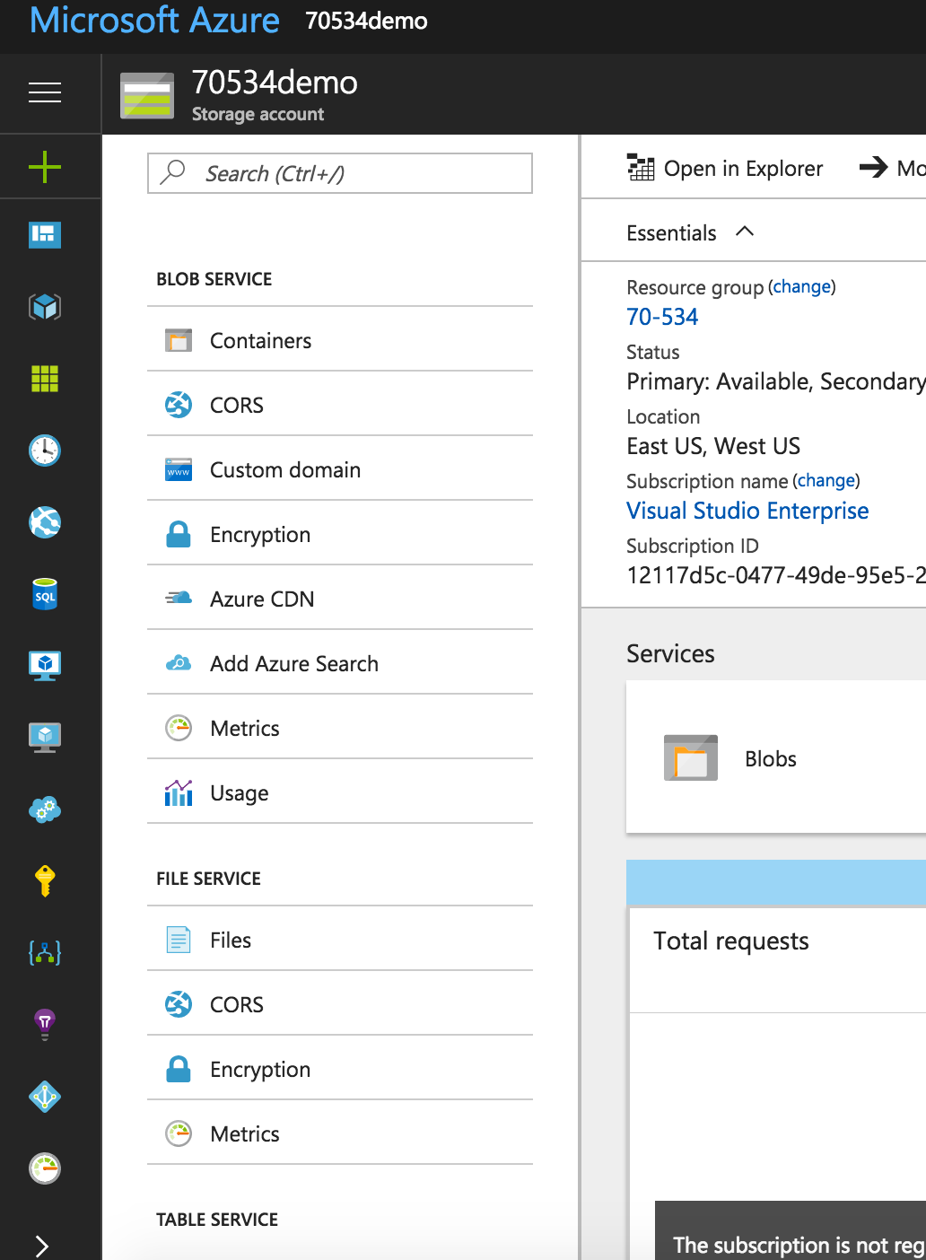
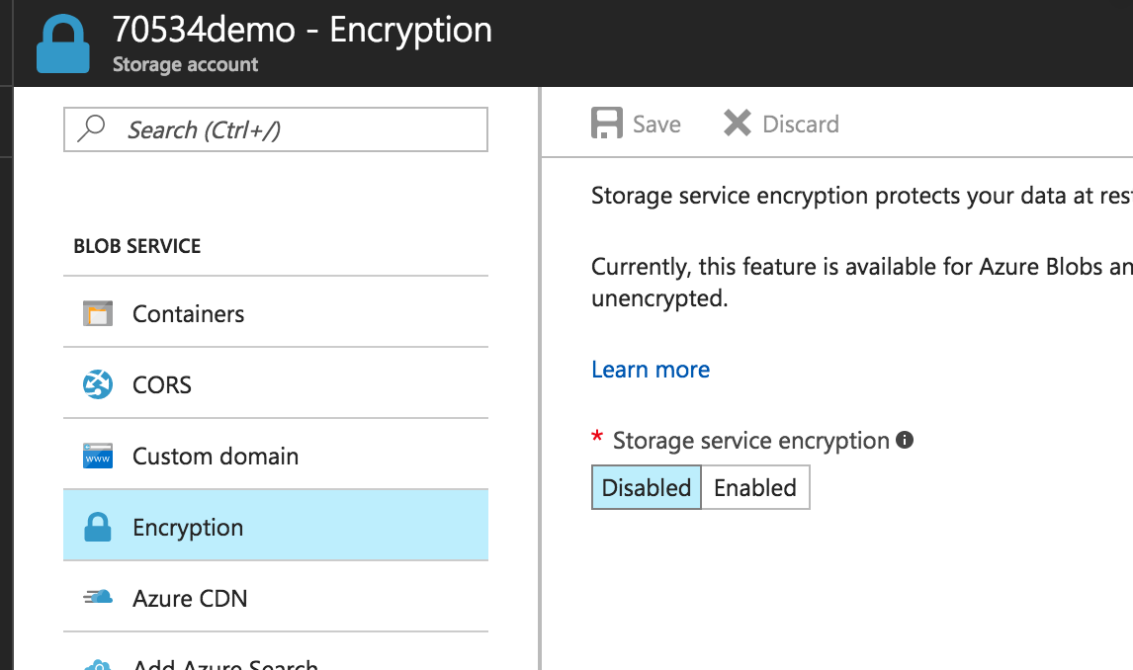
Storage Services Encryption
Notes:
Azure Storage Service Encryption (SSE) for Data at Rest helps you protect and safeguard your data to meet your organizational security and compliance commitments. With this feature, Azure Storage automatically encrypts your data prior to persisting to storage and decrypts prior to retrieval. The encryption, decryption, and key management are totally transparent to users.
SSE works by encrypting the data when it is written to Azure Storage, and can be used for Azure Blob Storage and File Storage. It works for the following:
Standard Storage: General purpose storage accounts for Blobs and File storage and Blob storage accounts
Premium storage
All redundancy levels (LRS, ZRS, GRS, RA-GRS)
Azure Resource Manager storage accounts (but not classic)
All regions.

Slide 43
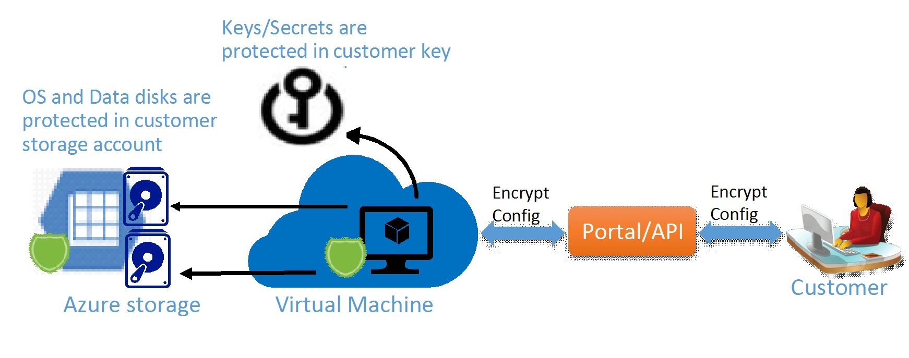
Azure Disk Encryption
Notes:
Azure Disk Encryption is a new capability that helps you encrypt your Windows and Linux IaaS virtual machine disks. Azure Disk Encryption leverages the industry standard BitLocker feature of Windows and the DM-Crypt feature of Linux to provide volume encryption for the OS and the data disks. The solution is integrated with Azure Key Vault to help you control and manage the disk-encryption keys and secrets in your key vault subscription. The solution also ensures that all data on the virtual machine disks are encrypted at rest in your Azure storage.
Azure disk encryption for Windows and Linux IaaS VMs is now in General Availability in all Azure public regions and AzureGov regions for Standard VMs and VMs with premium storage.
When you apply the Azure Disk Encryption-management solution, you can satisfy the following business needs:
IaaS VMs are secured at rest, because you can use industry-standard encryption technology to address organizational security and compliance requirements.
IaaS VMs boot under customer-controlled keys and policies, and you can audit their usage in your key vault.

Slide 44
Azure Disk Encryption Scenarios
Enable encryption on new IaaS VMs created from pre-encrypted VHD and encryption keys
Enable encryption on new IaaS VMs created from the Azure Gallery images
Enable encryption on existing IaaS VMs running in Azure
Disable encryption on Windows IaaS VMs
Disable encryption on data drives for Linux IaaS VMs
Enable encryption of managed disk VMs
Update encryption settings of an existing encrypted non-premium storage VM
Backup and restore of encrypted VMs, encrypted with key encryption key

Slide 45
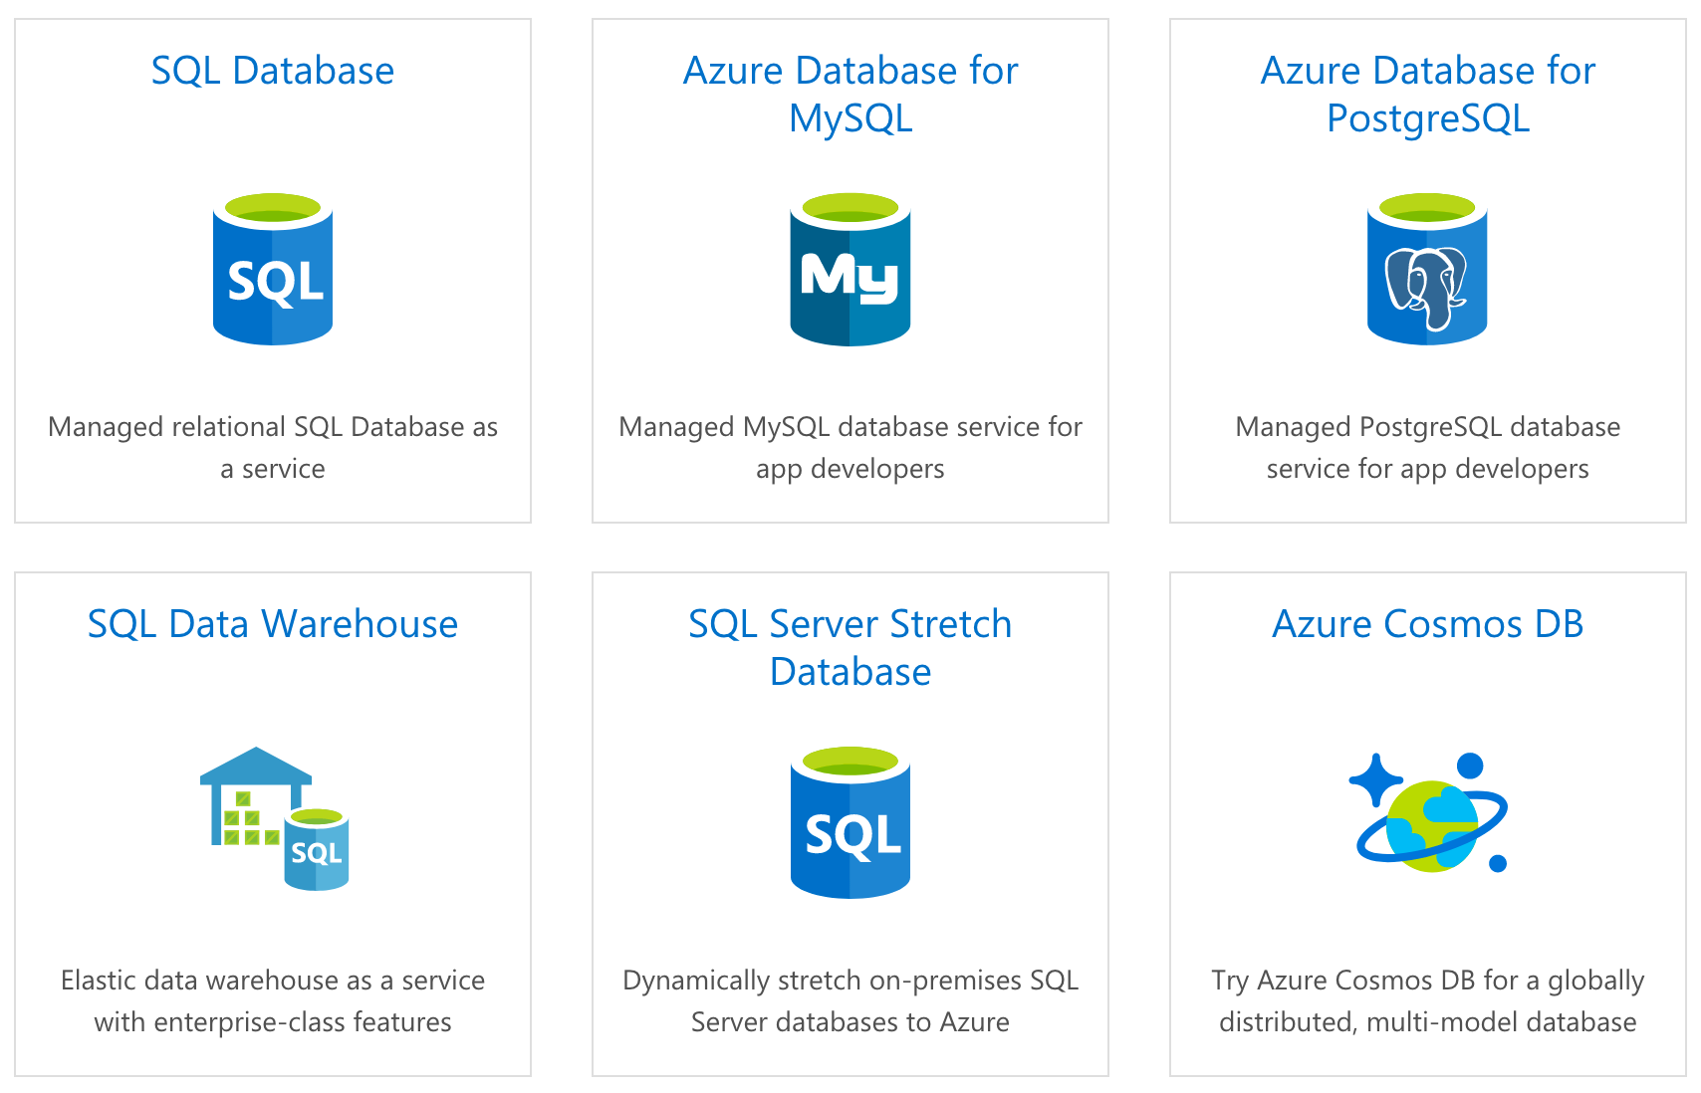
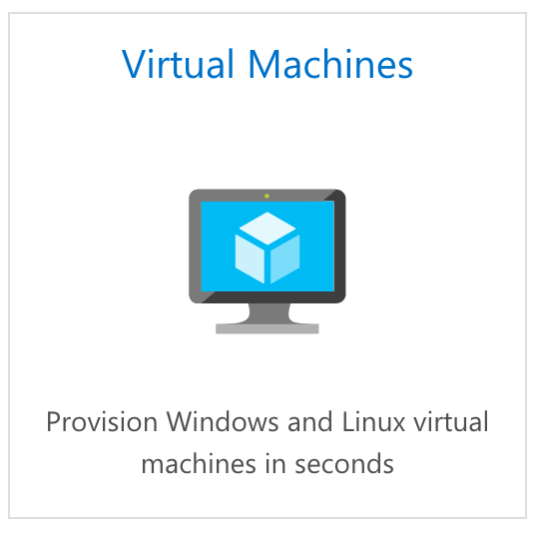
Azure Databases
Notes:
Mention SQL Server running on a VM in addition to the PAAS solutions.
It's not uncommon for solutions architects who are building out HIPAA compliant applications or apps that are similar with their security requirements to require encryption for the data that's in transit and at rest.

Slide 46
SQL Server TDE
Transparent Data Encryption
Applies to both PAAS and IAAS offerings
Covers both “in transit” and “at rest” encryption requirements
Notes:
So to facilitate that, SQL Server has a feature called Transparent Data Encryption abbreviated TDE. What it does is it encrypts the database, associated backups and transaction log files behind the scenes and allows us as developers to query the database without any changes to our code. So TDE is going to cover data at rest for SQL and for in transit, you'll want to use SSL with whatever libraries the developers are actually using.
When it comes to hosting SQL Server, you can go the platform as a service route and use Azure SQL and in that case, it's going to easily allow you to enable TDE via the portal, PowerShell or T-SQL or you could host it yourself either on-prem or with IaaS VMs and in that case, you can enable TDE. However, you also have more responsibility for securing the server, backups and everything else.

Slide 47
Azure Storage Client Library
Encrypting data within client applications before uploading to Azure Storage
Decrypting data while downloading to the client
Integrates with Azure Key Vault for storage account key management
Notes:
https://docs.microsoft.com/en-us/azure/storage/storage-client-side-encryption
The storage client library uses AES in order to encrypt user data. Specifically, Cipher Block Chaining (CBC) mode with AES.

Slide 48
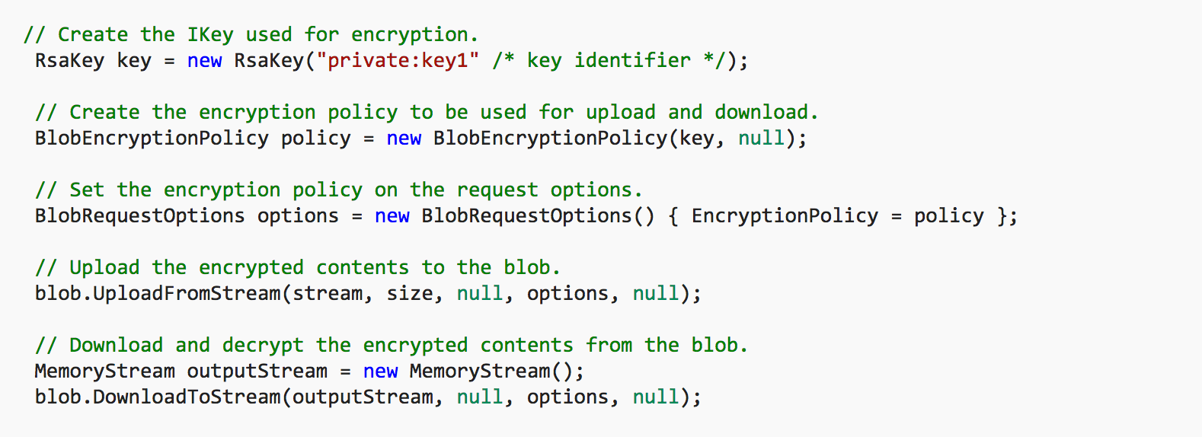
Azure Storage Client Library – Blob Example
Notes:
Create a BlobEncryptionPolicy object and set it in the request options (per API or at a client level by using DefaultRequestOptions). Everything else will be handled by the client library internally.

Slide 49
Design a role-based access control (RBAC) strategy

Slide 50
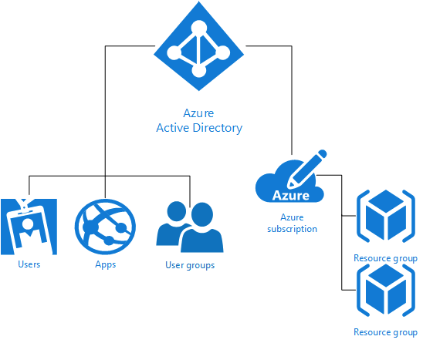
RBAC Overview
Notes:
Each Azure subscription is associated with one Azure Active Directory (AD) directory. Users, groups, and applications from that directory can manage resources in the Azure subscription. Assign these access rights using the Azure portal, Azure command-line tools, and Azure Management APIs.
Grant access by assigning the appropriate RBAC role to users, groups, and applications at a certain scope. The scope of a role assignment can be a subscription, a resource group, or a single resource. A role assigned at a parent scope also grants access to the children contained within it. For example, a user with access to a resource group can manage all the resources it contains, like websites, virtual machines, and subnets.
Using RBAC, you can segregate duties within your team and grant only the amount of access to users that they need to perform their jobs. Instead of giving everybody unrestricted permissions in your Azure subscription or resources, you can allow only certain actions. For example, use RBAC to let one employee manage virtual machines in a subscription, while another can manage SQL databases within the same subscription.

Slide 51
Role Levels
Manage Roles at…
Subscription Level
Resource Group Level
Resource Level
Notes:
Azure allows us to manage where a role is assigned, and there are three locations. At the subscription level, at a resource group level, or on a resource directly.
Now, the word resource tells us that this is all handled from the new portal or from PowerShell, the command line interface, or the REST API. Since the classic Portal is about services, and the new Portal is all about resources. Azure gives us a set of common built-in roles that we can use.
The list is fairly long, you can find it at https://docs.microsoft.com/en-us/azure/active-directory/role-based-access-built-in-roles

Slide 52
Custom Roles
Use when none of the built-in roles meet your needs
Each tenant can create up to 2000 custom roles.
Shared across all subscriptions that use a tenant
Comprised of Actions, NotActions, and AvailableScopes
Managed via Portal, PowerShell, Azure CLI, or the REST API
Notes:
Azure allows us to manage where a role is assigned, and there are three locations. At the subscription level, at a resource group level, or on a resource directly.
Now, the word resource tells us that this is all handled from the new portal or from PowerShell, the command line interface, or the REST API. Since the classic Portal is about services, and the new Portal is all about resources. Azure gives us a set of common built-in roles that we can use.
The list is fairly long, you can find it at https://docs.microsoft.com/en-us/azure/active-directory/role-based-access-built-in-roles

Slide 53
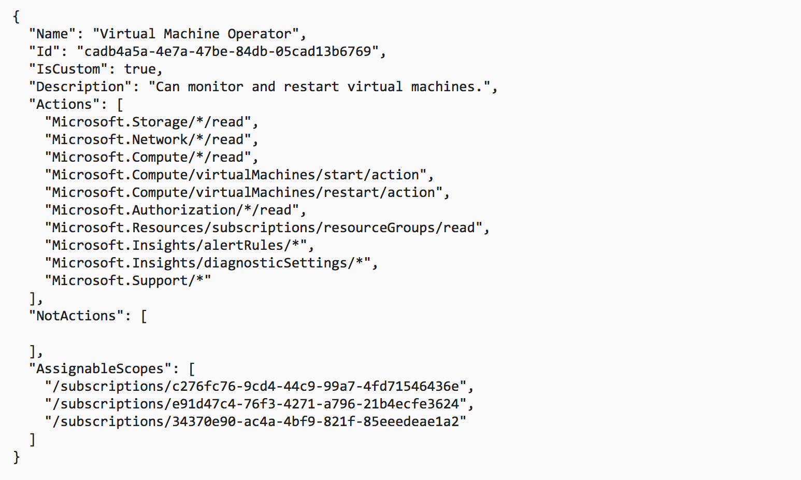
Custom Role Example
Notes:
This is an example of a custom role for monitoring and restarting virtual machines:

Slide 54
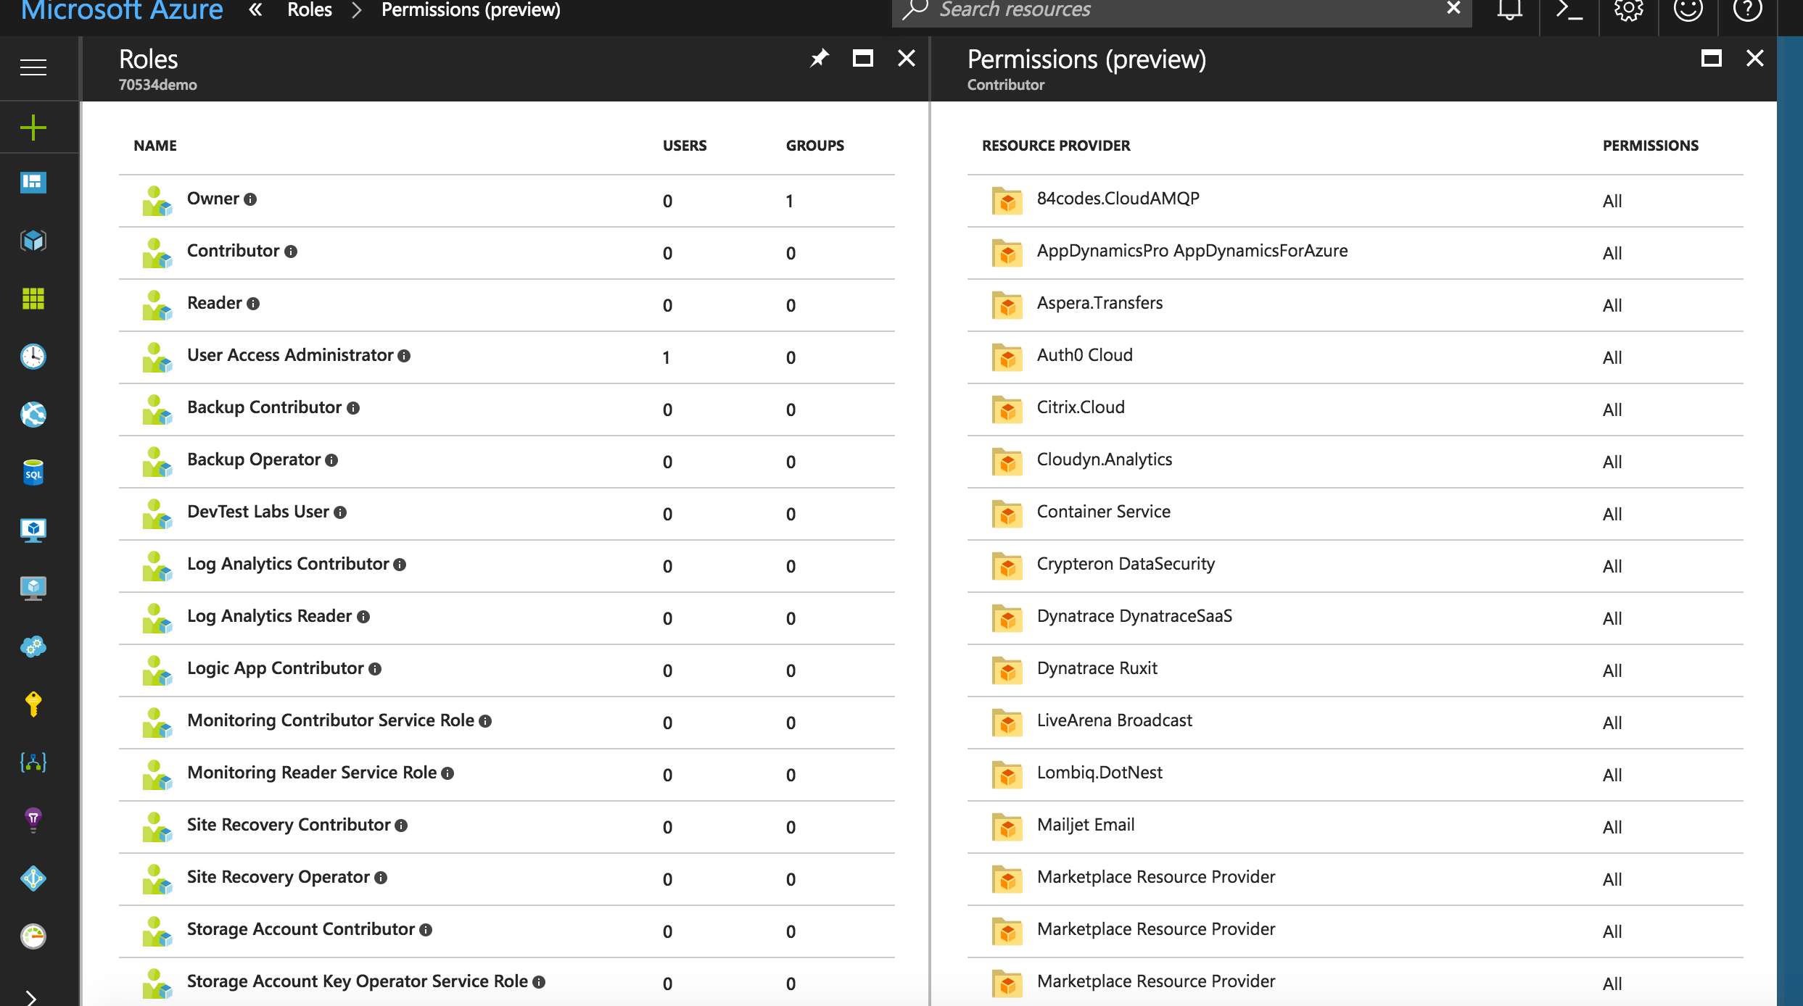
RBAC in the Azure Portal

